Slide 1
IRAD Program Review – ASSETS Thin Client
February 2016

Slide 2
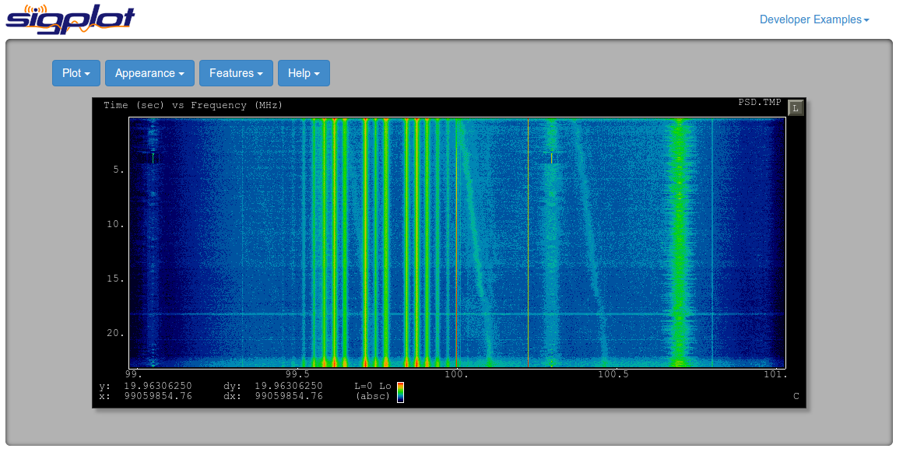
Project Dashboard – ASSETS Thin Client
Project Overview
Technical Approach
Support for Low-Bandwidth/High Latency Network Links
Design and definition of the SigPlot Data Service API. This API will provide the following functionality:
Dynamic server side compression and/or decimation to reduce bandwidth consumption of streaming plots
Tile-based server side rendering for large-scale rasters
Development of SigPlot client-side libraries to interact with the SigPlot Data Service API
Development of reference implementation of SigPlot Data Service API
Development of Demonstration Applications
Development of a Snapshot Analysis tool using Polymer, node.js, and liquidsdr. This tool would demonstrate functionality desired by the Spectrum OPS and Single View project
Integration of SigPlot into the CubicSDR baseline to provide a real-time streaming demonstration platform.
Optimization of SigPlot plotting algorithms
Development of a benchmarking suite for SigPlot
Execution of the benchmarking suite with a focus on reducing SigPlot processing and memory consumption.
SigPlot provides a familiar and flexible web-native plotter, built using HTML5 technologies. SigPlot was designed and implemented to support a wide-variety of use-cases with easy integration into any existing web application
SigPlot has been already been adopted by multiple projects across various agencies; however, continued growth requires investment in both baseline maintenance and the development of unique capabilities, notably:
Support for efficient plotting over low-bandwidth/high-latency networks
Development of demonstration application(s)
Optimization of SigPlot plotting algorithms

Slide 3
Project Dashboard – ASSETS Thin Client
Spend Plan
Execution Plan
$50k funded, $25k unfunded
Budget as of May 18th, 2016
SigPlot Data Service (Michael Ihde, Mark Leone)
(Q2) Coordinate with M5.0/REDHAWK to gather API requirements
(Q2) Produce draft API definition
(Q2) Produce final API definition
(Q3) Develop reference implementation in coordination with the Snapshot Demonstration App
Snapshot Demonstration App (Devin Nelson, David Hickernell)
(Completed) Coordinate with Spectrum OPS/New Moon to define the feature set desired in the demonstration app. Identify opportunities for shared effort between the projects.
(Q2) Wrap liquidsdr libraries in Python compatible form.
(Q2) Establish basic framework for application using Polymer, Python-Flask, liquidsdr, and the SigPlot Data Service
(Q2) Demonstrate minimum-viable capability
(Q3) Demonstrate final capability
Streaming Demonstration App (Michael Recachinas)
(Completed) Asses technical viability of using CubicSDR as the demonstration platform.
(Completed) Demonstrate prototype capability of CubicSDR feeding SigPlot using web-sockets
(Q3) Demonstrate final capability
Benchmarking/Optimization (David Hickernell)
(Completed) Develop benchmark framework and methodology
(Q4) Finalize and asses improvements to SigPlot algorithms.

Slide 4
Q1 (Feb-May) Status – ASSETS Thin Client
Accomplishments
Next Steps
Established benchmarking framework that is automated and repeatable.
Benchmarking is automated within the Grunt framework so that it ties into the same system used for builds and unittests
Benchmarking for various browsers is automated through the Karma testing framework.
Benchmarking results are stored so that performance regressions can be automatically flagged
The CubicSDR-based streaming application prototype has been established
Web-socket support has been added to CubicSDR to allow access to display streams
A basic view-only display has been created using SigPlot
The WebCubicSDR application has been Dockerized to support easy deployment and testing
Established Design for Snapshot Analysis Application
Established requirements for initial snapshot application
Established architecture for snapshot application
SigPlot Data Service API
Coordinate with M5.0 and REDHAWK users to capture requirements for API
Document API such that it can be implemented for the snapshot and streaming application demos
Streaming Application
Establish capability to issue commands to the CubicSDR backend for controlling the application
Augment CubicSDR with the ability to take snapshots of pre-D data
Snapshot Application
Establish basic client-side UI design
Establish client-side and server-side frameworks
Develop initial set of capability to produce a minimally-viable demonstration application that includes time-domain and frequency domain analysis capabilities

Slide 5
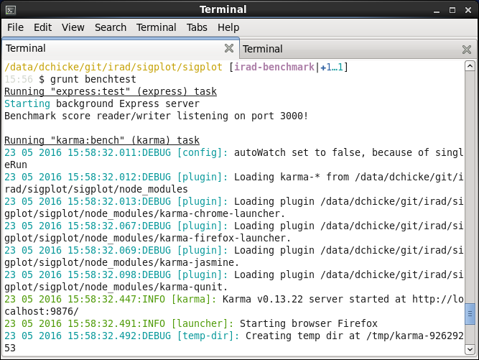
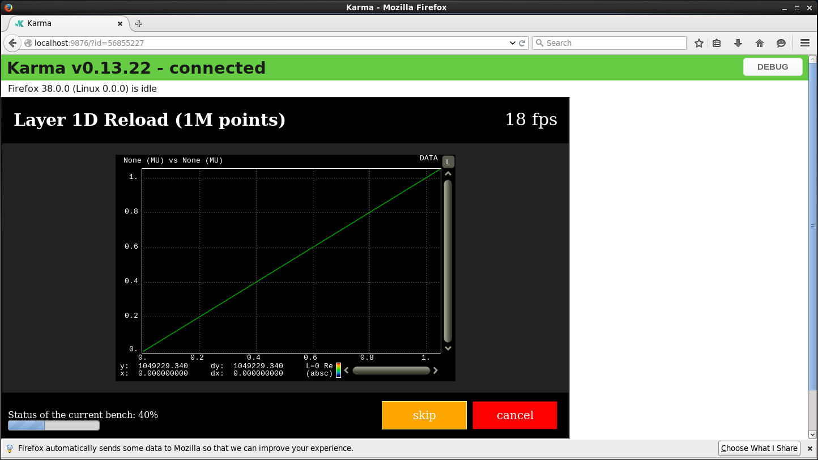
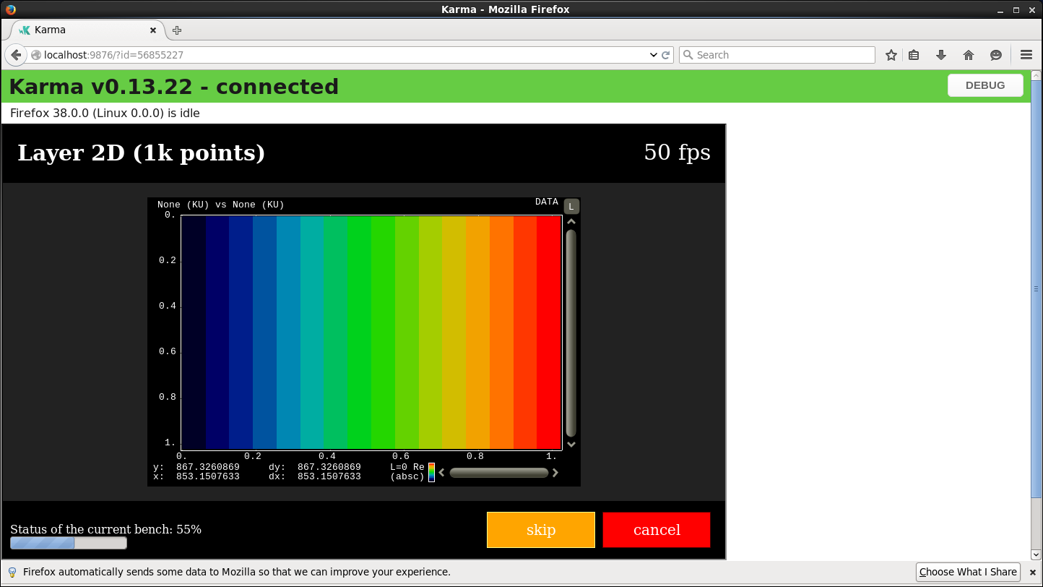
Benchmarking – ASSETS Thin Client
Benchmarking is available directly from within the Grunt build system
Karma is used to execute the benchmarks for different browser combinations automatically
Benchmarking results are stored and analyzed to automatically flag performance regressions
Benchmark.json

Slide 6
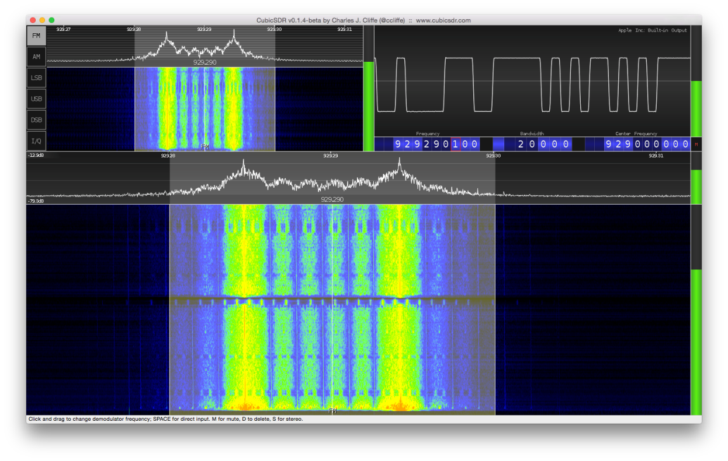
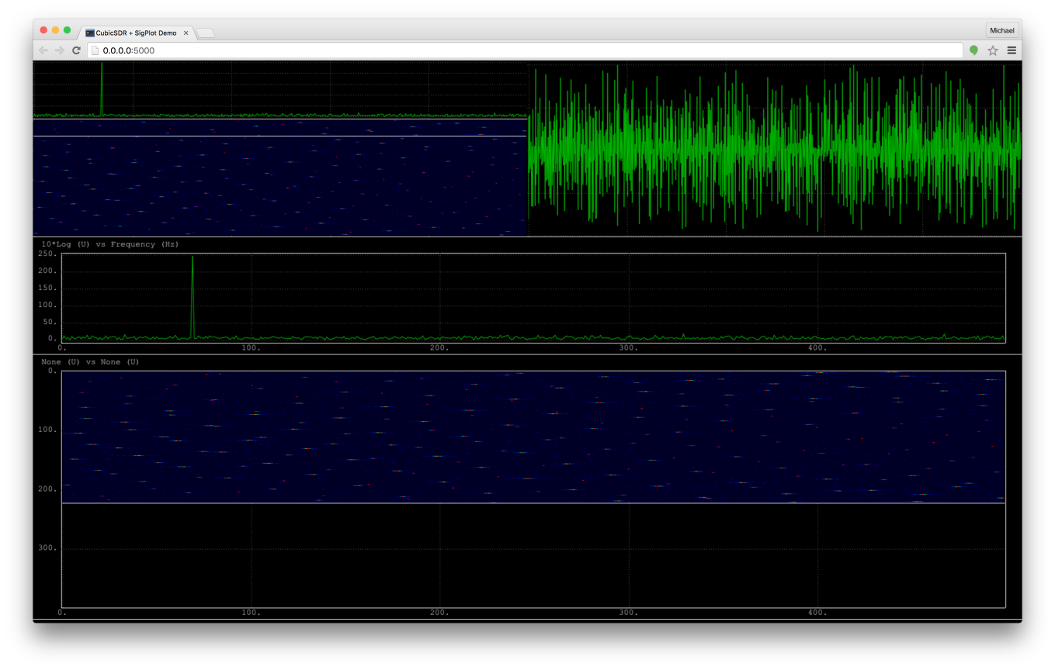
CubicSDR Application – ASSETS Thin Client
The CubicSDR plots are rendered with SigPlot
The streaming data is sent via web-socket from the CubicSDR server to the webbrowser
The CubicSDR radio controls will be implemented in the webbrowser
The SigPlot look-and-feel will be tailored to mimic the desktop CubicSDR
Note: SigPlot screenshots based off sinusodial test signal with noise.

Slide 7
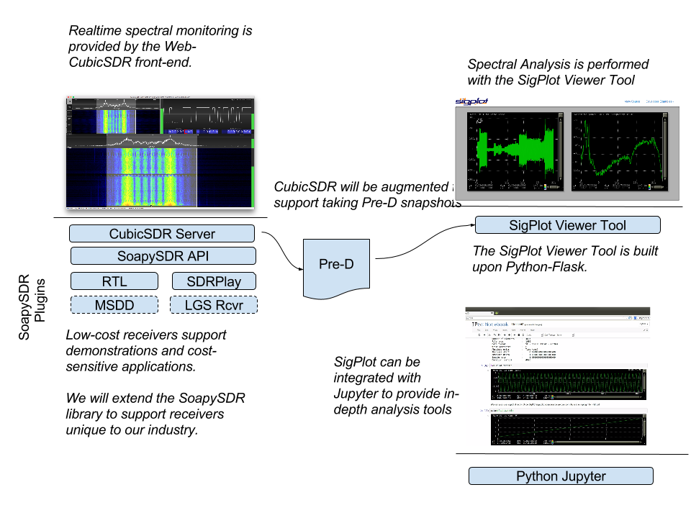
Snapshot Application – ASSETS Thin Client

Slide 8
Backup Slides

Slide 9
Original Project Dashboard – ASSETS Thin Client
Spend Plan
Execution Plan
$50k funded, $25k unfunded
Required Hardware: None
Required Software: None
Spend Plan:
SigPlot Data Service: 2 weeks
Snapshot Demonstration App: 6 weeks
Streaming Demonstration App: 3 weeks
Benchmarking/Optimization: 2 weeks
Total: 13 weeks
9 weeks funded
4 weeks unfunded
SigPlot Data Service (Mark Leone)
(+1 week) Coordinate with M5.0/REDHAWK to gather API requirements
(+ 3 week) Produce draft API definition
(+ 6 week) Produce final API definition
(+16 week) Develop reference implementation in node.js along with corresponding SigPlot integration.
Snapshot Demonstration App (Michael Recachinas)
(+1 week) Coordinate with Spectrum OPS/New Moon to define the feature set desired in the demonstration app. Identify opportunities for shared effort between the projects.
(+3 week) Wrap liquidsdr libraries in node.js compatible form.
(+16 week) Establish basic framework for application using Polymer, node.js, liquidsdr, and the SigPlot Data Service
(+32 week) Demonstrate minimum-viable capability
(+48 week) Demonstrate final capability
Streaming Demonstration App (Youssef Bagoulla)
(+2 week) Asses technical viability of using CubicSDR as the demonstration platform.
(+16 week) Demonstrate prototype capability of CubicSDR feeding SigPlot using web-sockets
(+32 week) Demonstrate final capability
Benchmarking/Optimization (Michael Ihde)
(+24 week) Develop benchmark framework and methodology
(+48 week) Finalize and asses improvements to SigPlot algorithms.

